Slide 1

MIET-KWIF
Final Evaluation
Presenter
Kavya Dhar(2020A1R112)
Presented To:
CSE DEPARTMENT
DEPARTMENT OF COMPUTER SCIENCE AND ENGINEERING
MIET(Autonomous), JAMMU

Slide 2
Contents
Training Topics
Problem Statement
Solution
Tech Stack
Features
Workflow
References
Future Scope
Demonstration

Slide 3


TRAINING TOPICS
Training consists of Three parts:
Python
Tkinter
Fire-Base

Slide 4
Training Topics
Introduction
History
Features
Setting up path
Working with Python
Basic Syntax
Variable and Data Types
Operator
Conditional statement
If
If- else
Nested if-else
Looping
For
While
Nested loops
Control Statements
Break
Continue
Pass
String Manipulation
Accessing Strings
Basic Operations
String slices
Function and Method
Data Structure
List
Tuple
Dictionary
Function
Defining a function
Calling a function
Types of functions
Function Arguments
Anonymous functions
Global and local variables
Modules
Importing module
Time module
Random module
Packages
Composition
OOPS
Class and object
Attributes
Inheritance
Overloading
Overriding
Data Hiding
Exception Handling
Exception
Exception Handling
Except clause
Try-finally clause
User Defined Exceptions

Slide 5
Training Topics(Continued)
Database
Introduction
Connections
Executing queries
Transactions
Handling error
GUI Programming
Introduction
Tkinter programming
Tkinter widgets
Firebase Real-Time Programming
Introduction
Create Project
Updation In Record (JSON format )
We have used topic like OOPS,Exception handling,Tkinter,Database for creating our project which we will see in detail in further slides

Slide 6
Problem Statement
Quiz Contest is an application developed to conduct a Quiz based on time constraints! Quiz Contest system is accessed by entering the username and password which is added to the database!
The whole first question on the quiz is displayed, and the response alternatives are all based on general knowledge computations. Correct score is increased by one, and there are no failing grades or errors.
After providing answers to a few short questions, the quiz application will eventually lead you to the score page if the time surpasses 20 seconds. The database will be updated with the final score and shown along with the username.

Slide 7
Objective:
The main objective of “Quiz Contest” is to facilitate a user-friendly environment for all users and reduces the manual effort.
In past days quiz is conducted manually but in further resolution of the technology we can generate the score and pose the queries automatically.
The functional requirements include to create users that are going to participate in the quiz, automatic score and report generation and administrative tasks like add, delete, update for admin privilege users.
In this application, all the permissions lies with the administrator i.e., specifying the details of the quiz with checking result will show to interviewee or not, addition of question and answers, marks for each question, Set timer for each quiz and generate report with score for each quiz.

Slide 8
Tech Stack
Tkinter Frontend
Python
SQLite
Backend

Slide 9
Software Requirements:
Operating System: Cross Platform ( We are Using Windows)
Toolkit: Python IDE for professional developers(PyCharm Pro 2022.03)
Platform: Python 3 and Django + Tkinter
Database: SQLite
Hardware Requirements:
PyCharm Pro
Windows 8 or Above

Slide 10
WORKFLOW

Slide 11
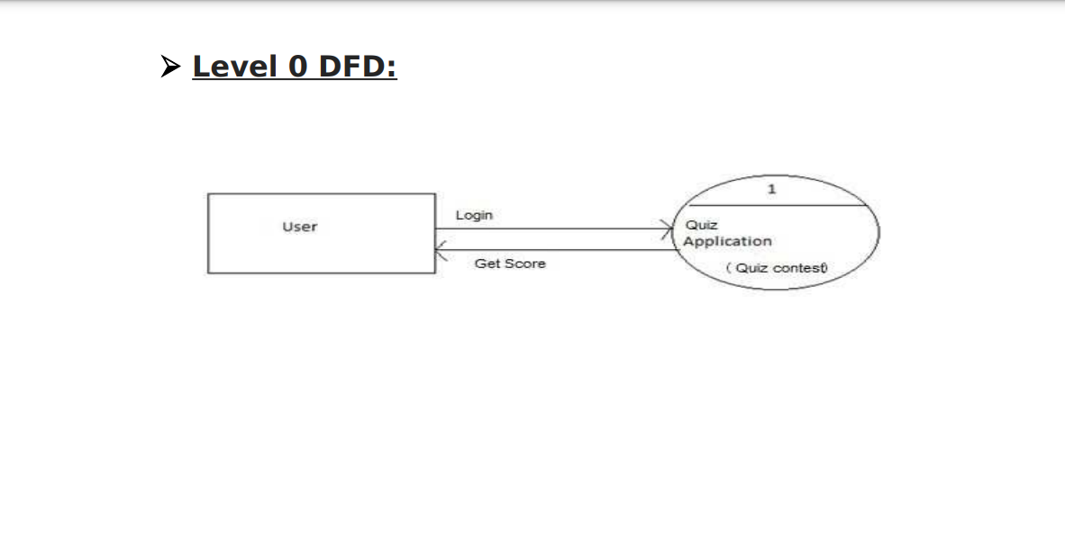
Diagram:
Data Flow Diagram (DFD):
A data low diagram (DFD) is a graphical representation of the "low" of data through an information system, modeling its process aspects. A DFD is often used as a preliminary step to create an overview of the system. DFDs can also be used for the visualization of data processing. A DFD shows what kind of information will be input to and output from the system, where the data will come from and go to, and where the data will be stored. It does not show information about the timing of process or information about whether processes will operate in sequence or in parallel.
Fig: 1

Slide 12
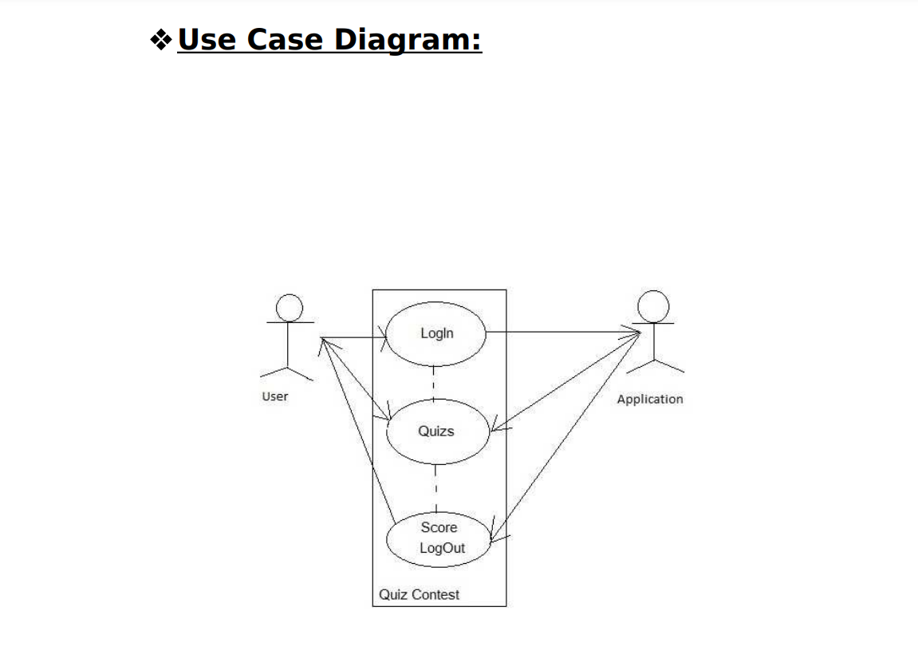
Fig: 2

Slide 13
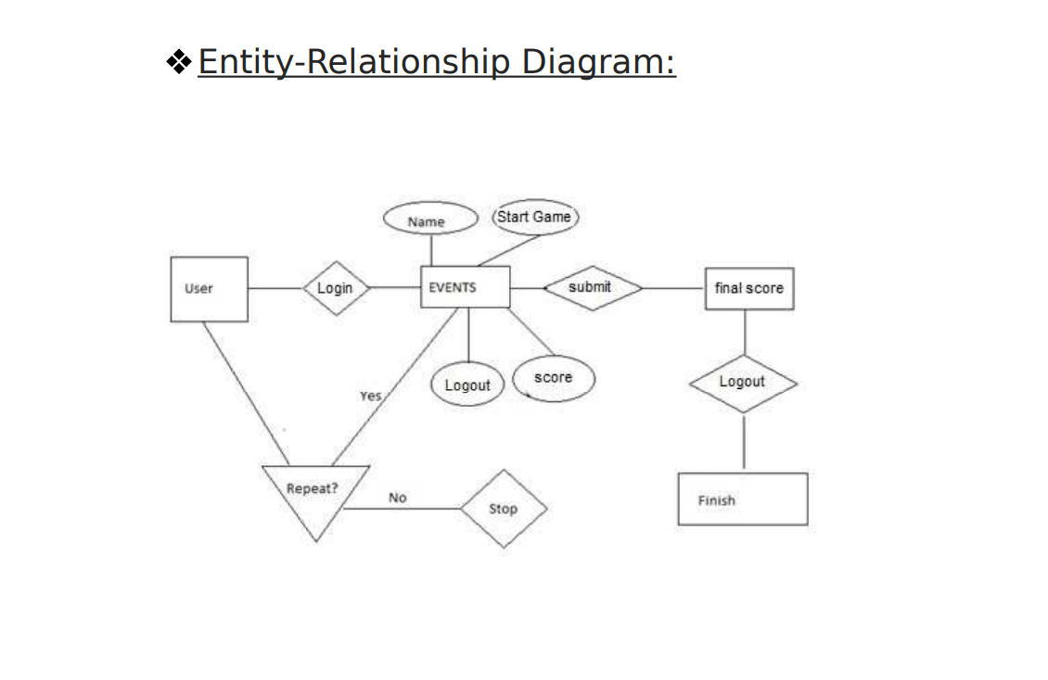
Fig:3

Slide 14
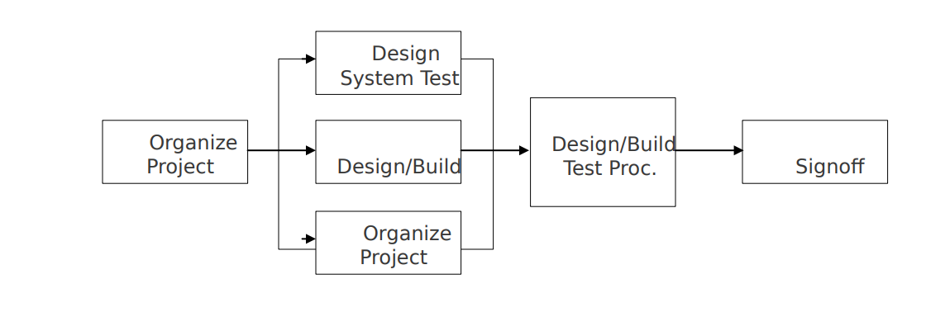
Testing Process:
Fig:4

Slide 15
The diagram above outlines the Test Process approach that will be followed.:
Organize Project involves creating a System Test Plan, Schedule & Test Approach, and assigning responsibilities.
Design/Build System Test involves identifying Test Cycles, Test Cases, Entrance & Exit Criteria, Expected Results, etc. In general, test conditions/expected results will be identified by the Test Team in conjunction with the Development Team. The Test Team will then identify Test Cases and the Data required. The Test conditions are derived from the Program Specifications Document.
Design/Build Test Procedures includes setting up procedures such as Error Management systems and Status reporting.
Build Test Environment includes requesting/building hardware, software and data setups.

Slide 16
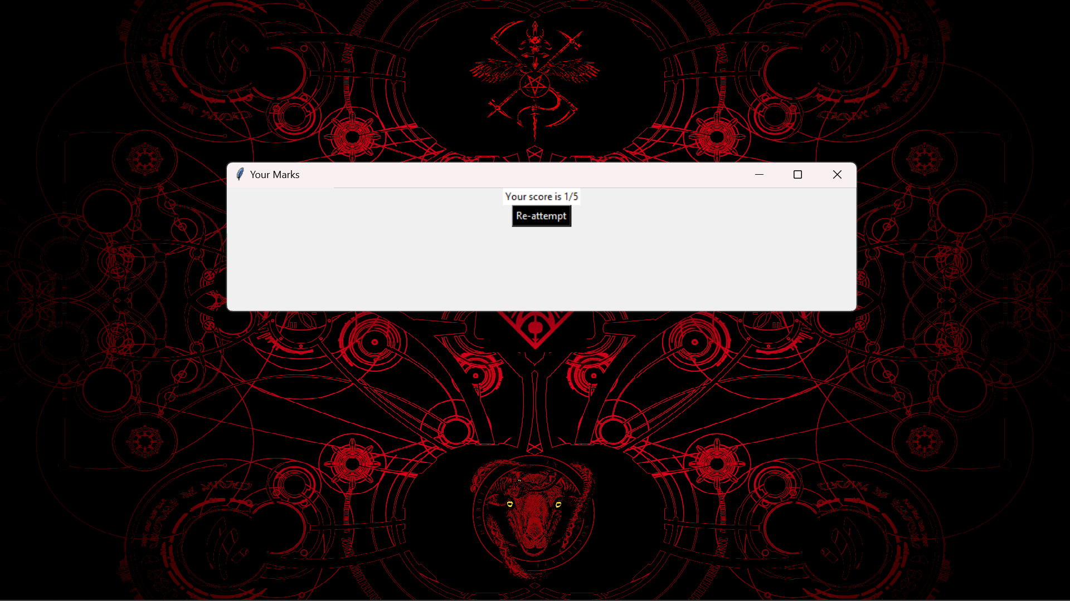
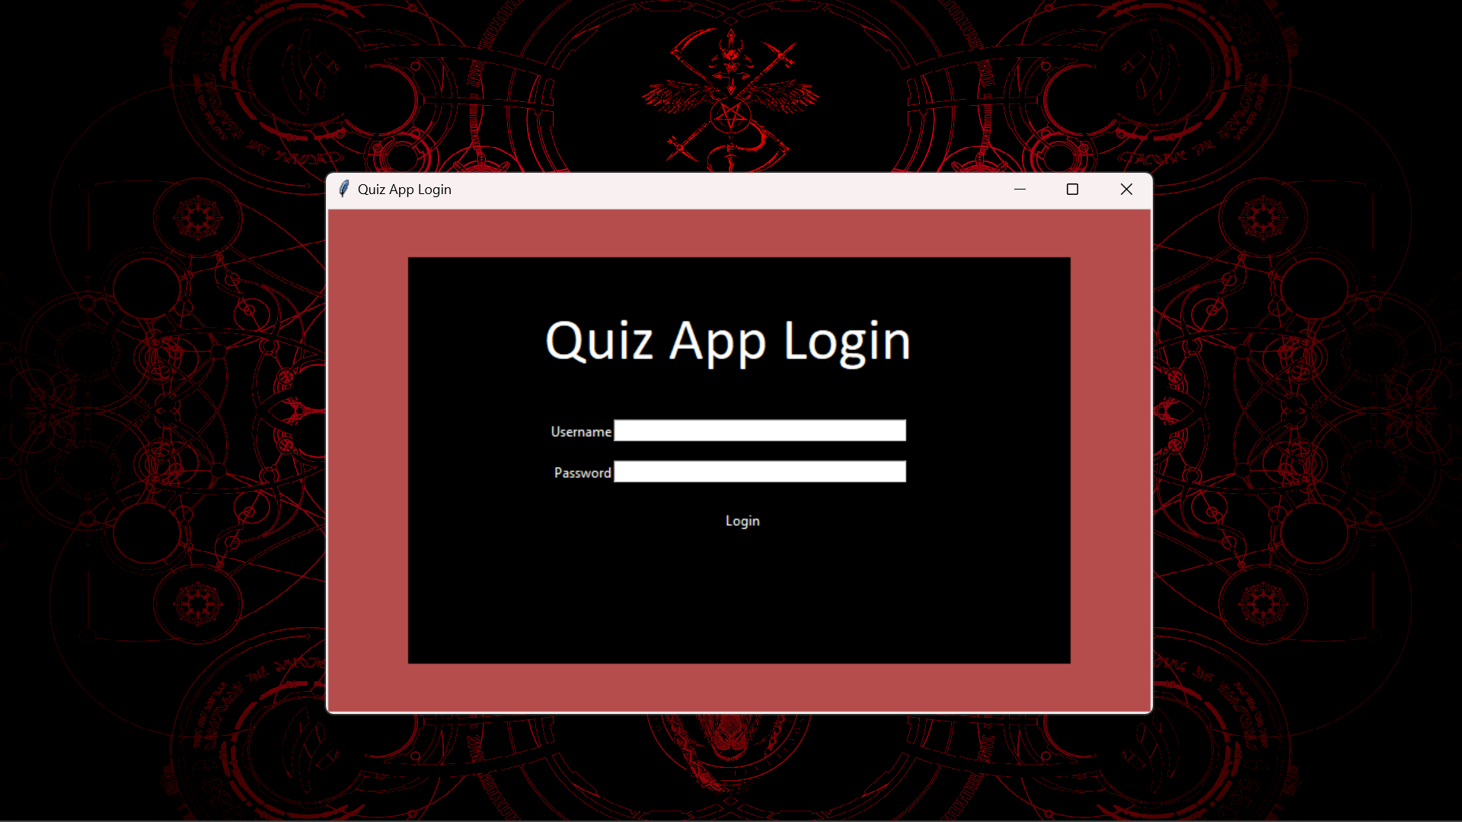
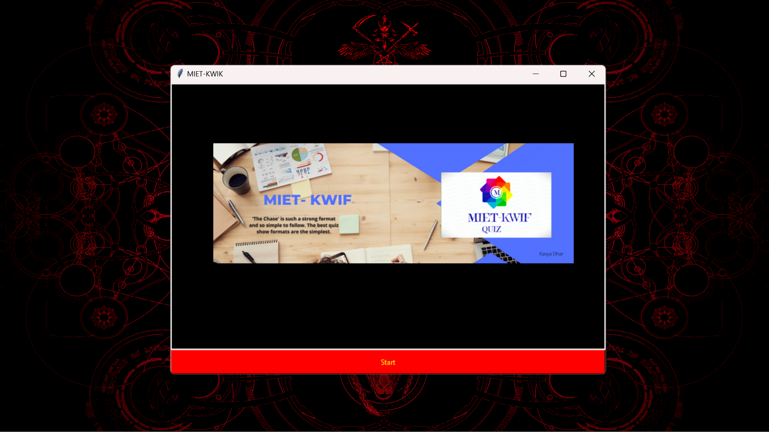
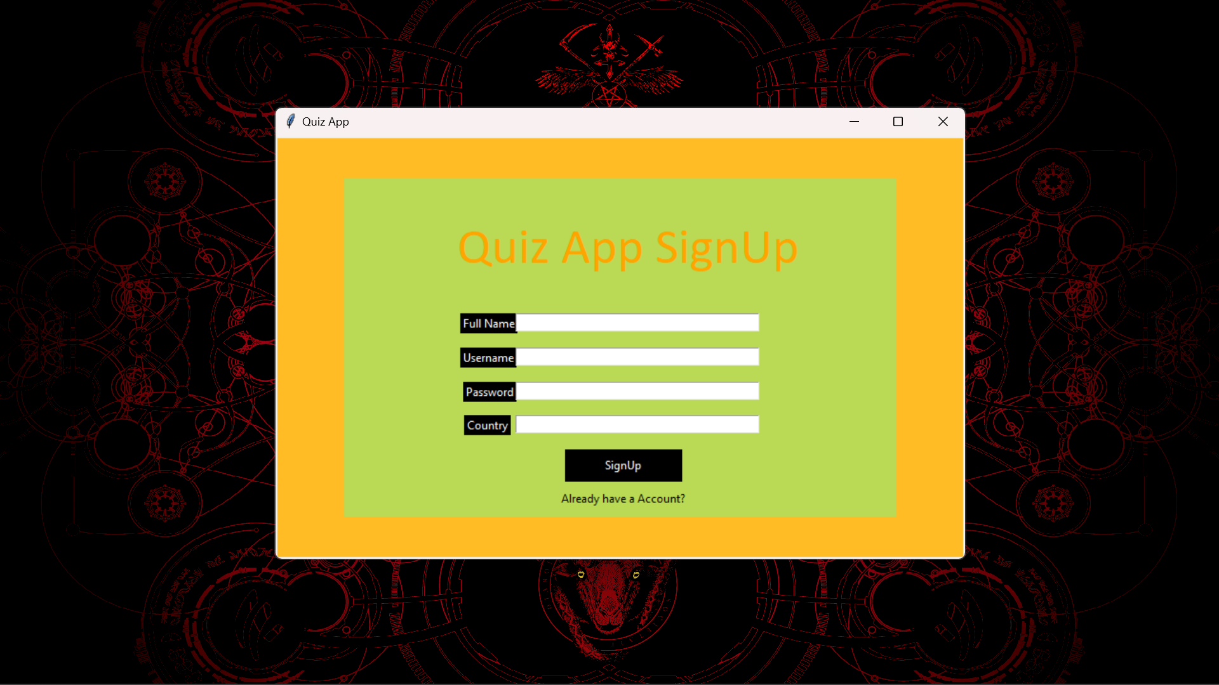
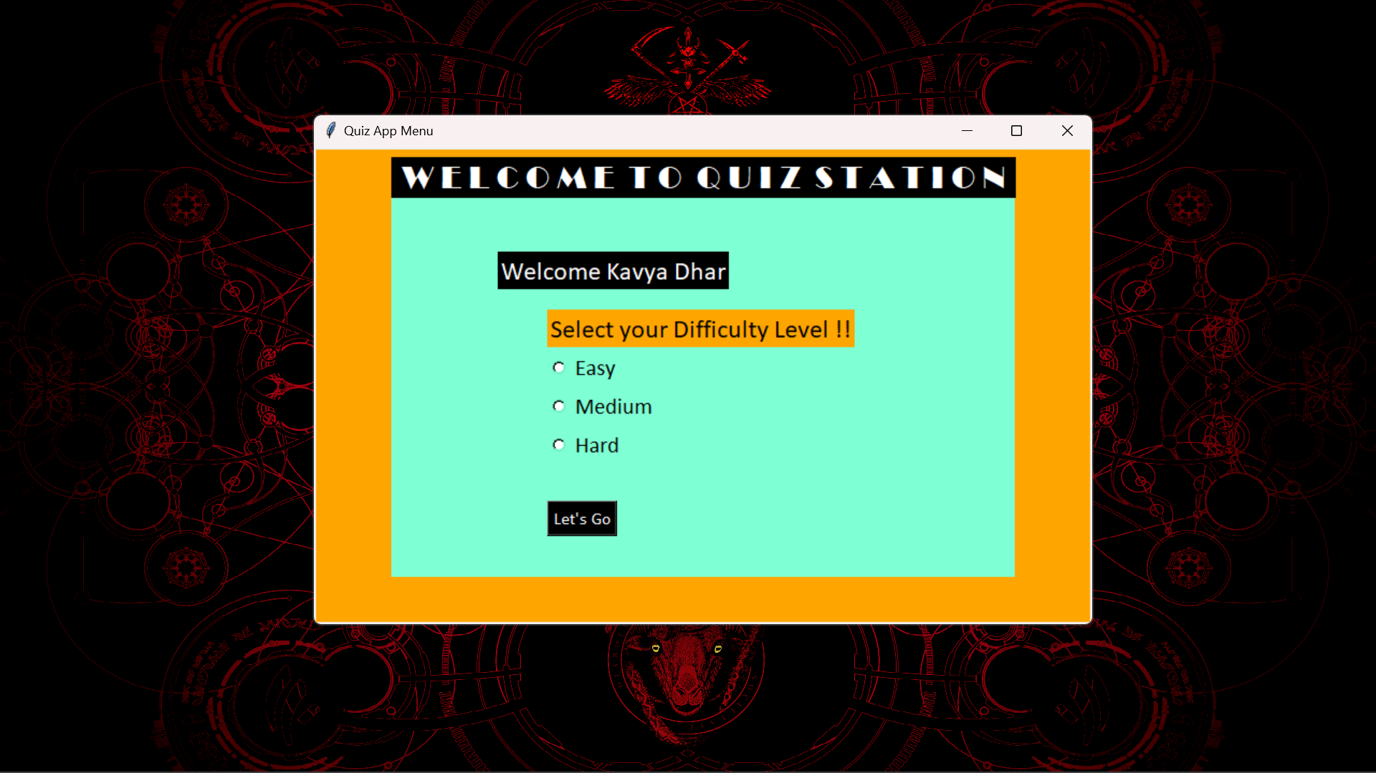
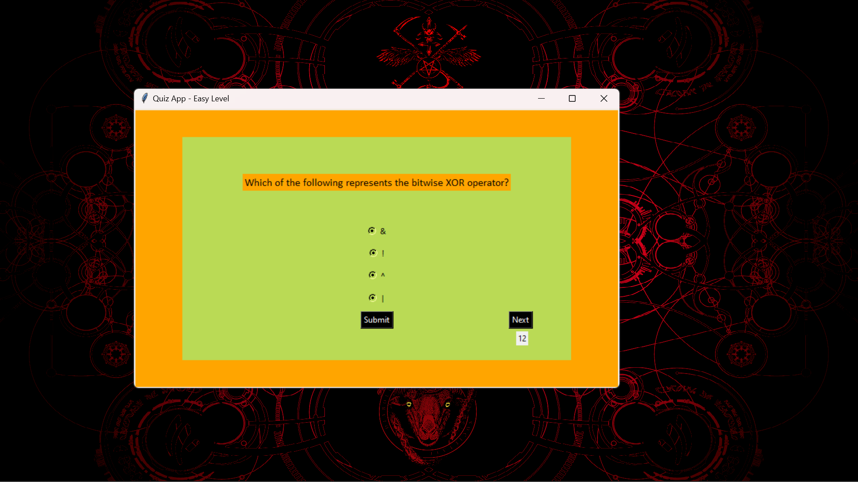
RESULTS:

Slide 17
References
Neil Smyth, Community Studio Development
Essentials,1 edition, Create Space Independent
Publishing Platform(July 22, 2014).
Ronan Schwartz & Phil Dotson, Building
Applications with the Community PyCharm, 2 edition,
Addison Wesley Professional(2013).
David J. Eck, Java Virtual Machine, 7 edition,
University Press of Florida(2014).
Troy Drowning and John Meyer, Java Virtual
Machine, Edition 1, O’Reilly Media (1997).
E. Burnette, Hello Community, the Pragmatic
Programmers, 2 Edition, Pragmatic
Bookshelf(2009).
R. Meier, Professional Community 2 Application
Development, 2 edition, John Wiley &Sons(2010).

Slide 18
Future Scope
Data Visualization.
Data analysis.
Integration with mobile application for ease of use.

Slide 19
DEMONSTRATION

Slide 21


